Slide 1
Sampling Theory and Pulse Code Modulation Course Teacher Dr. Monir Morshed Professor, Dept. of ICT Email:monirmorshed.ict@mbstu.ac.bd

Slide 2
Pulse Modulation: Introduction
Many Signals in Modern Communication Systems are digital . Also, analog signals are transmitted digitally.
Reduced distortion and improvement in signal to noise ratios.
PAM, PWM , PPM , PCM and DM.
Data transmission, digital transmission, or digital communications is the physical transfer of data (a digital bit stream or a digitized analogue signal) over a point-to-point or point-to multipoint communication channel

Slide 3
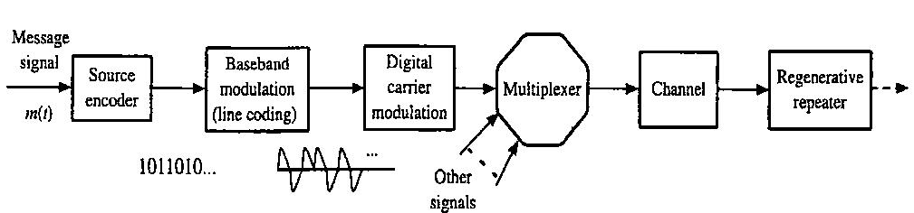
Digital Communication System
Analog to Digital Conversion is carried out here

Slide 4
Digital Communication System
Advantages of digital communication systems:
Easy way of transmission of signals
Connection of more calls through one channel i.e., Multiplexing is possible using Digital Communication.
Source Encoding and Channel Encoding can be used to detect errors at the received signal.
Using repeaters between source and destination, we can reproduce the original signal with less distortions.
Security is the major advantage of digital communication compared to Analog Communication.
Transmitting analogue signals digitally allows for greater signal processing capability.
Digital communication can be done over large distances through internet and other things.
The messages can be stored in the device for longer times, without being damaged.
Advancement in communication is achieved through Digital Communication.

Slide 5
Digital Communication System
Disadvantages of digital communication systems:
Sampling Error
Digital communications require greater bandwidth than analogue to transmit the same information.
The detection of digital signals requires the communications system to be synchronized, whereas generally speaking this is not the case with analogue systems.
Digital signals are often the approximation of voice signals, ie, we don't get the exact analogue signal.

Slide 6
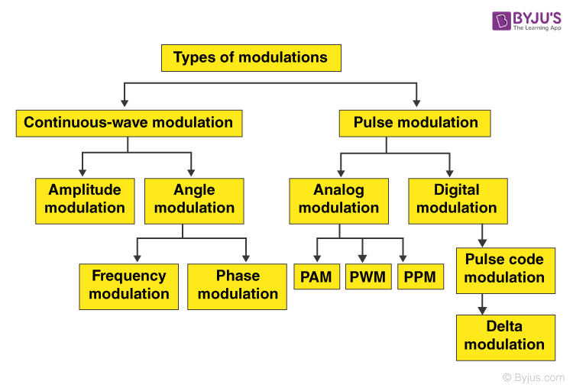
Pulse Modulation: Introduction

Slide 7
Analog Pulse Modulation
Analog pulse modulation results when some attribute of a pulse varies continuously in one-to-one
In analog pulse modulation systems, the amplitude, width, or position of a pulse can vary over a continuous range in accordance with the message amplitude at the sampling instant.
Three types of pulse modulation:
Pulse Amplitude Modulation (PAM)
Pulse Width Modulation (PWM)
Pulse Position Modulation (PPM)

Slide 8
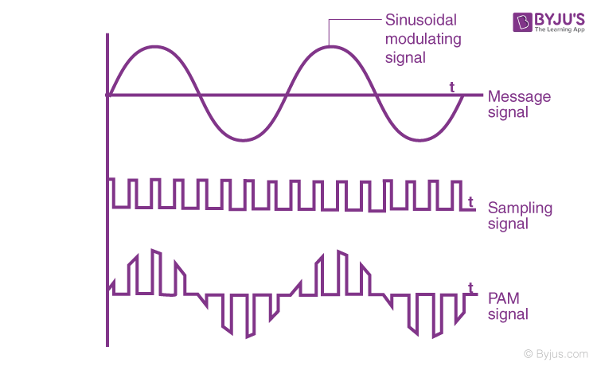
Pulse Amplitude Modulation (PAM)
In this scheme high frequency carrier (pulse) is varied in accordance with sampled value of message signal

Slide 9
Pulse Amplitude Modulation (PAM)
Advantages of PAM
Both Modulation and demodulation are simple.
Easy construction of transmitter and receiver circuits.
Disadvantages of PAM
Large bandwidth is required for transmission.
More noise.
Here the amplitude is varying. Therefore, the power required will be more.
Applications of PAM
Mainly used in Ethernet communication.
Many microcontrollers use this technique in order to generate control signals.
It is used in Photo-biology.
It acts as an electronic driver for LED circuits

Slide 10
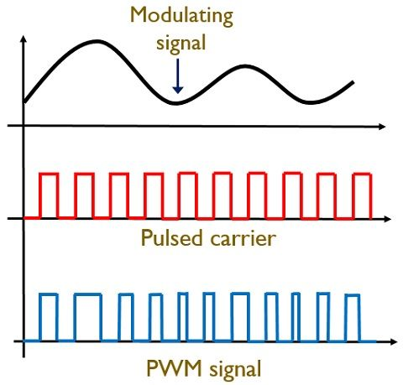
Pulse Width Modulation (PWM)
In this width of carrier pulses are varied in accordance with sampled values of message signal. Example: Speed control of DC Motors. It is also called pulse time modulation

Slide 11
Pulse Width Modulation (PWM)
Advantages of PTM
Low power consumption.
It has an efficiency of about 90 per cent.
Noise interference is less.
High power handling capacity.
Disadvantages of PTM
The circuit is more complex.
Voltage spikes can be seen.
The system is expensive as it uses semiconductor devices.
Switching losses will be more due to high PWM frequency.
Applications of PTM
Used in encoding purposes in the telecommunication system.
Used to control brightness in a smart lighting system.
Helps to prevent overheating in LED’s while maintaining it’s brightness.
Used in audio and video amplifiers.

Slide 12
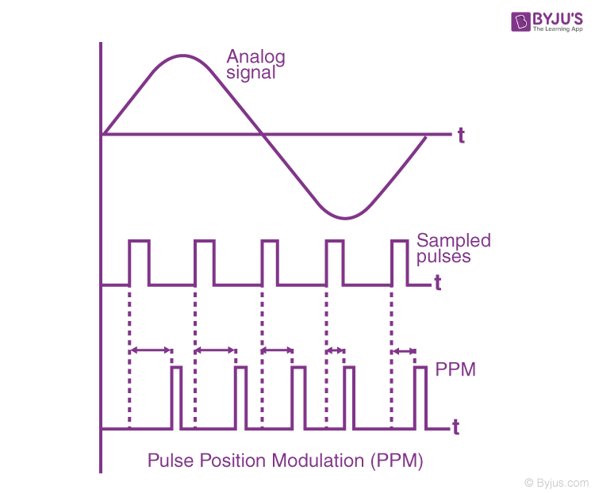
Pulse Position Modulation (PPM)
In this scheme position of high frequency carrier pulse is changed in accordance with the sampled values of message signal.

Slide 13
Pulse Position Modulation (PPM)
Advantages of PPM
As it has constant amplitude noise interference is less.
We can easily separate signal from a noisy signal.
Among all three types, it has the most power efficiency.
Requires less power when compared to pulse amplitude modulation.
Disadvantages of PPM
The system is highly complex.
The system requires more bandwidth.
Applications of PPM
It is used in the air traffic control system and telecommunication systems.
Remote controlled cars, planes, trains use pulse code modulations.
It is used to compress data and hence it is used for storage.

Slide 14
Digital Pulse Modulation
In systems utilizing digital pulse modulation, the transmitted samples take on only discrete values. Two important types of digital pulse modulation are:
Pulse Code Modulation (PCM)
Delta Modulation (DM)

Slide 15
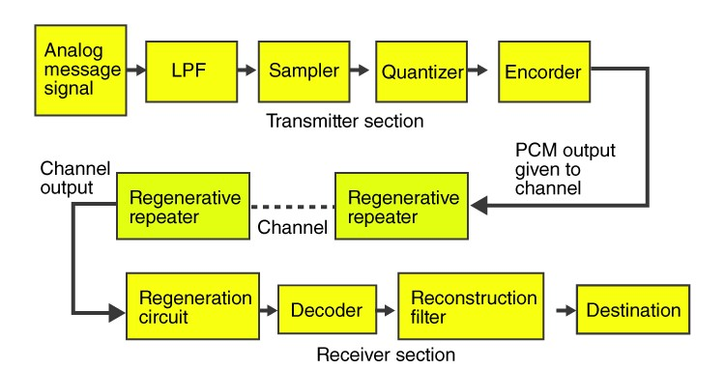
Pulse Code Modulation (PCM)
PCM is most useful and widely useful for all pulse modulation.
PCM basically is a tool for converting an analog signal into a digital signal (A/D conversion).
An analog signal can be converted into a digital signal by means of sampling and quantizing.
Quantizing is a rounding off signal value to one of the closest permissible number (or quantizing levels).
A binary digital signal is very desirable because of its simplicity, economy, and ease of engineering.

Slide 16
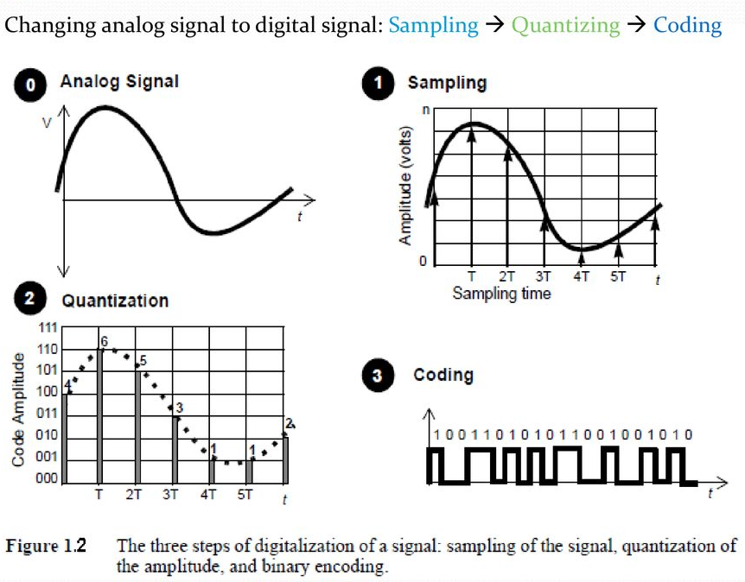
Pulse Code Modulation (PCM)

Slide 17
Pulse Code Modulation (PCM)
Advantages of PCM
It is mainly used in long distant communication.
Transmitter efficiency is more.
It has higher noise immunity when compared to other methods.
Disadvantages of PCM
More bandwidth is required when compared to analogue systems.
In this method encoding, decoding and quantization of the circuit have to be done. This makes it more complex.
Applications of PCM
It is used in the satellite transmission system.
It is also used in space communication.
Used in Telephony.
One of the recent applications is the compact disc.

Slide 18
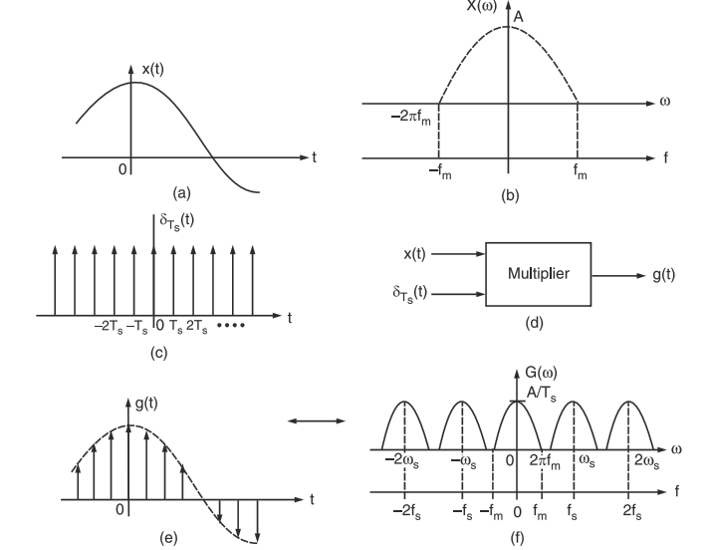
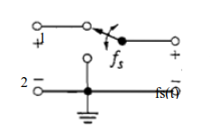
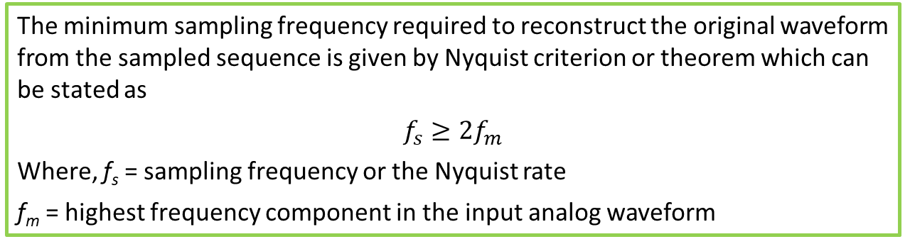
Sampling Theorem
The minimum sampling frequency required to reconstruct the original waveform from the sampled sequence is given by Nyquist criterion or theorem which can be stated as
$$f_{s}≥2f_{m}$$
Where, f_{s} = sampling frequency or the Nyquist rate
f_{m} = highest frequency component in the input analog waveform

Slide 19
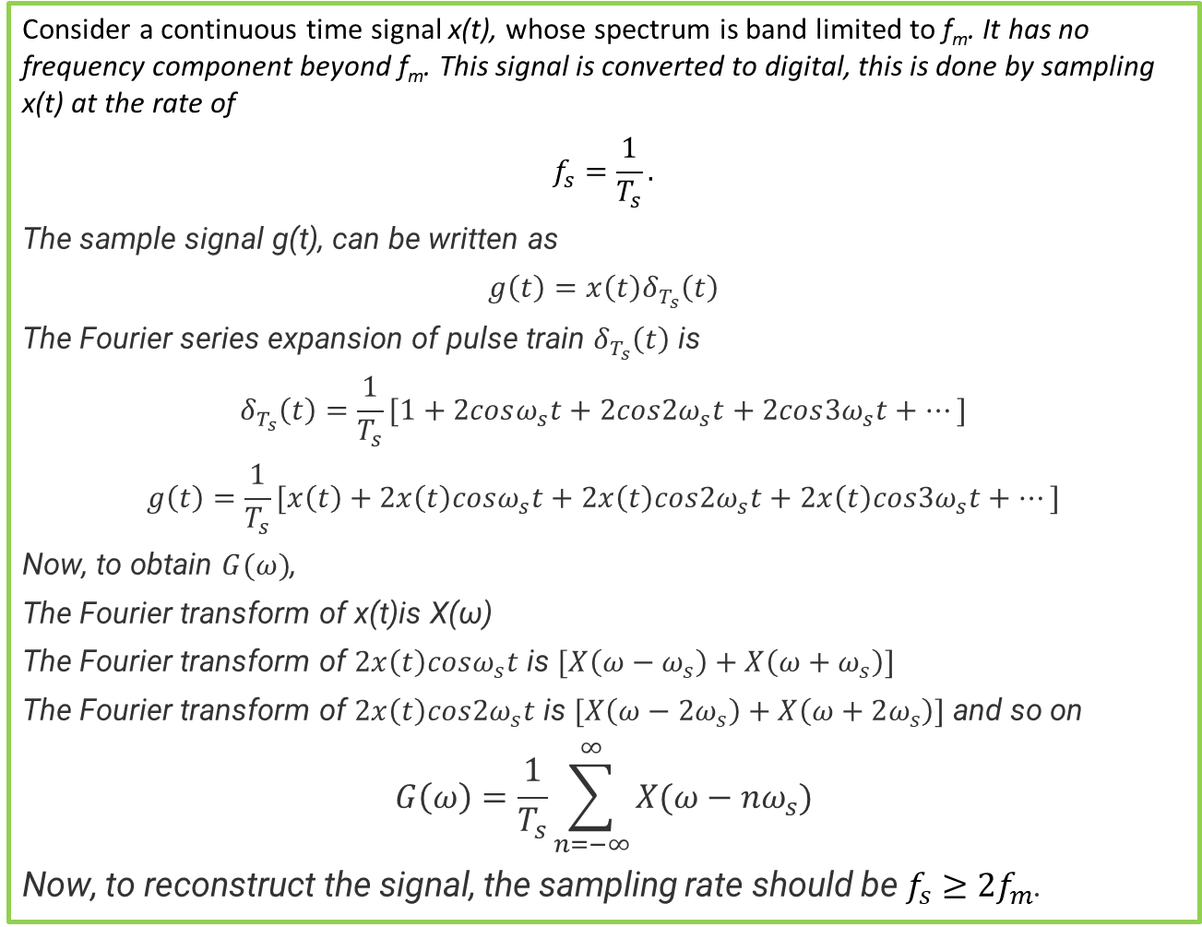
Sampling Theorem
Consider a continuous time signal x(t), whose spectrum is band limited to f_{m}. It has no frequency component beyond f_{m}. This signal is converted to digital, this is done by sampling x(t) at the rate of
$$f_{s}=\frac{1}{T_{s}}.$$
The sample signal g(t), can be written as
$$g\left(t\right)=x\left(t\right)δ_{T_{s}}\left(t\right)$$
The Fourier series expansion of pulse train $δ_{T_{s}}\left(t\right)$ is
$$δ_{T_{s}}\left(t\right)=\frac{1}{T_{s}}[1+2cosω_{s}t+2cos{2ω}_{s}t+2cos{3ω}_{s}t+…]$$
$$g\left(t\right)=\frac{1}{T_{s}}[x\left(t\right)+2x\left(t\right)cosω_{s}t+2x\left(t\right)cos{2ω}_{s}t+2x\left(t\right)cos{3ω}_{s}t+…]$$
Now, to obtain $G(ω)$,
The Fourier transform of x(t)is X(ω)
The Fourier transform of $2x\left(t\right)cosω_{s}t$ is $[X\left(ω−ω_{s}\right)+X\left(ω+ω_{s}\right)]$
The Fourier transform of $2x\left(t\right)cos{2ω}_{s}t$ is $[X\left(ω−{2ω}_{s}\right)+X\left(ω+2ω_{s}\right)]$ and so on
$$G\left(ω\right)=\frac{1}{T_{s}}\sum_{n=−∞}^{∞}{X(ω−{nω}_{s})}$$
Now, to reconstruct the signal, the sampling rate should be $f_{s}≥2f_{m}$.

Slide 20
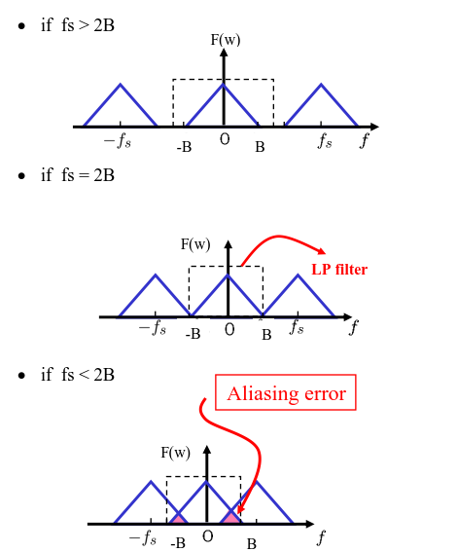
Sampling Theorem

Slide 21
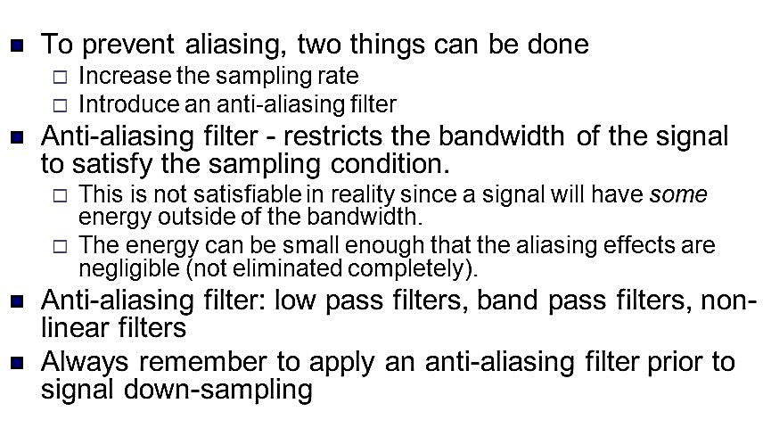
How to Avoid Aliasing

Slide 22
Example
See example 9.1, 9.2, 9.3, 9.4 from Sanjay Sharma Books

Slide 23
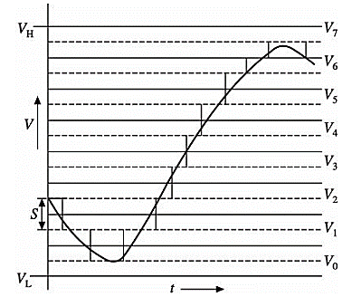

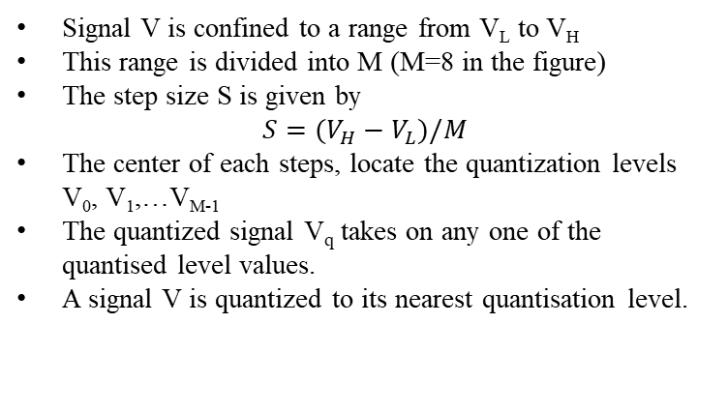
Quantizing
Quantizing is a process of reducing the excessive bits and confining the data. The sampled output when given to Quantizer, reduces the redundant bits and compresses the value.
In order to process the sampled signal digitally, the sample values have to be quantized to a finite number of levels, and each value can then be represented by a string of bits.
To quantize a sample value is to round it to the nearest point among a finite set of permissible values,
Therefore, a distortion will inevitably occur. This is called quantization noise (or error).
Signal V is confined to a range from V_{L} to V_{H}
This range is divided into M (M=8 in the figure)
The step size S is given by
$$S=(V_{H}−V_{L})/M$$
The center of each steps, locate the quantization levels V₀, V₁,…V_{M-1}
The quantized signal V_{q} takes on any one of the quantised level values.
A signal V is quantized to its nearest quantisation level.

Slide 24
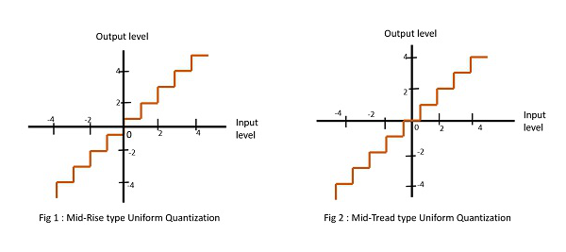
Quantizing
The quantization process can be classified into two types as under:
Quantization
Uniform Quantization
Non-uniform Quantization
Midtread type
Midrise type
Uniform Quantizer: A uniform Quantizer has the same step size through the signal range

Slide 25
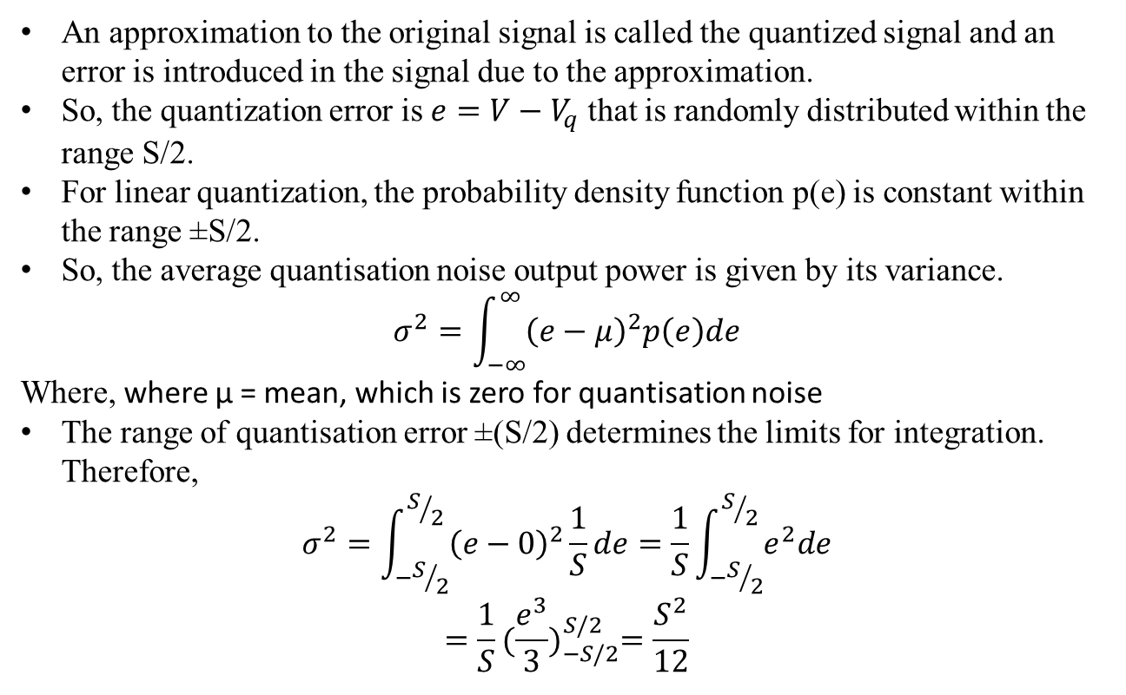
Quantization Noise or Error
An approximation to the original signal is called the quantized signal and an error is introduced in the signal due to the approximation.
So, the quantization error is $e=V−V_{q}$ that is randomly distributed within the range S/2.
For linear quantization, the probability density function p(e) is constant within the range ±S/2.
So, the average quantisation noise output power is given by its variance.
$$σ^{2}=\int_{−∞}^{∞}{{\left(e−μ\right)}^{2}p\left(e\right)de}$$
Where, where μ = mean, which is zero for quantisation noise
The range of quantisation error ±(S/2) determines the limits for integration. Therefore,
$$σ^{2}=\int_{−S/2}^{S/2}{{\left(e−0\right)}^{2}\frac{1}{S}de}=\frac{1}{S}\int_{−S/2}^{S/2}{e^{2}de}$$
$$=\frac{1}{S}{(\frac{e^{3}}{3})}_{−S/2}^{S/2}=\frac{S^{2}}{12}$$

Slide 26
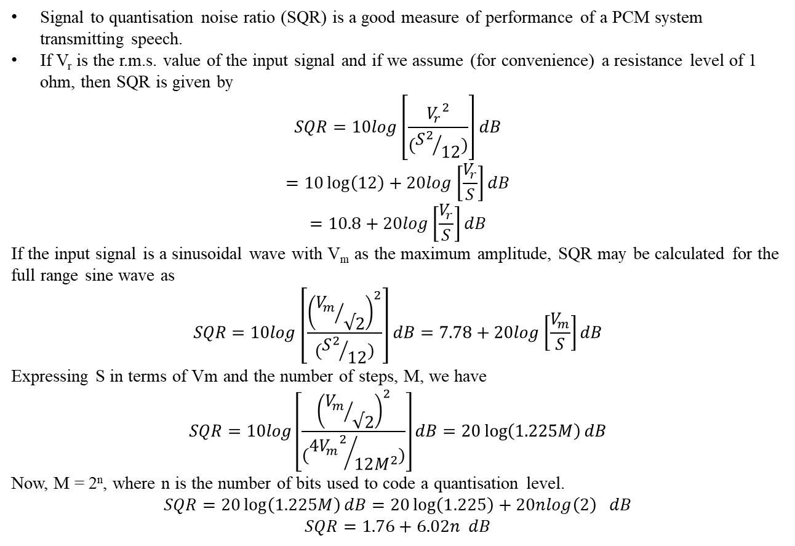
Quantization Noise or Error
Signal to quantisation noise ratio (SQR) is a good measure of performance of a PCM system transmitting speech.
If V_{r} is the r.m.s. value of the input signal and if we assume (for convenience) a resistance level of 1 ohm, then SQR is given by
$$SQR=10log\left[\frac{{V_{r}}^{2}}{({S^{2}}/{12})}\right]dB$$
$$=10\log\left(12\right)+20log\left[\frac{V_{r}}{S}\right]dB$$
$$=10.8+20log\left[\frac{V_{r}}{S}\right]dB$$
If the input signal is a sinusoidal wave with V_{m} as the maximum amplitude, SQR may be calculated for the full range sine wave as
$$SQR=10log\left[\frac{{\left({V_{m}}/{√2}\right)}^{2}}{({S^{2}}/{12})}\right]dB=7.78+20log\left[\frac{V_{m}}{S}\right]dB$$
Expressing S in terms of Vm and the number of steps, M, we have
$$SQR=10log\left[\frac{{\left({V_{m}}/{√2}\right)}^{2}}{({{4V_{m}}^{2}}/{12M^{2}})}\right]dB=20\log\left(1.225M\right)dB$$
Now, M = 2^{n}, where n is the number of bits used to code a quantisation level.
$$SQR=20\log\left(1.225M\right)dB=20\log\left(1.225\right)+20nlog\left(2\right) dB$$
$$SQR=1.76+6.02n dB$$

Slide 27
Quantization Noise or Error
The following table gives the values of SQR for different binary code word sizes for sinusoidal input systems. It may be seen that every additional code bit gives an improvement of 6 dB in SQR.
n (bits) | M(levels) | Voltage ratio (1.225M) | SQR (dB)
2 | 4 | 4.9 | 13.8
4 | 16 | 19.6 | 25.8
6 | 64 | 78.4 | 37.8
7 | 128 | 156.8 | 43.8
8 | 256 | 313.6 | 49.8
9 | 512 | 627.2 | 55.8
10 | 1024 | 1254.4 | 61.8

Slide 28
Binary PCM
The essential features of binary PCM are illustrated by means of an example shown in the figure below

